Slide 1
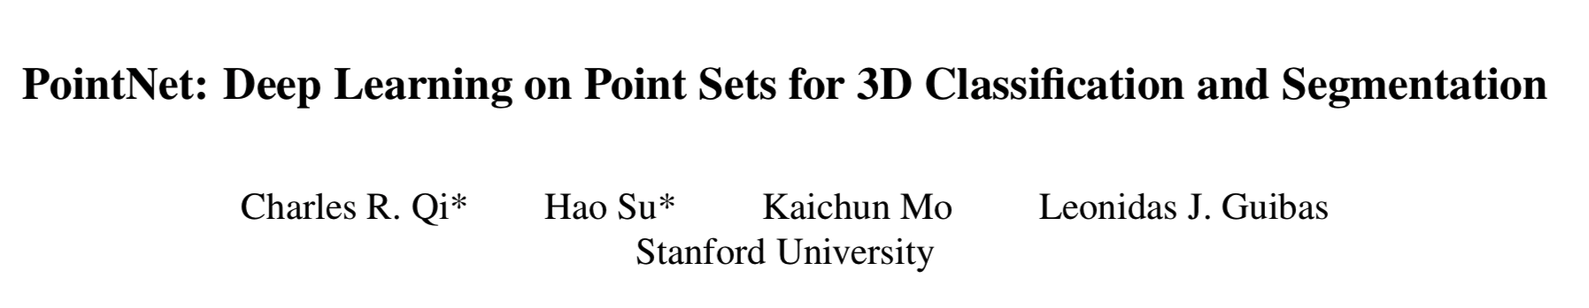

Source
http://stanford.edu/~rqi/pointnet/
CVPR 2017
EE 5885/COSC 5010 Advances in 3D Computer Vision

Slide 2
Introduction
Related works
Problem statement
Deep Learning on Point Sets
Properties of Point Sets in R^{n}
PointNet Architecture
Theoretical Analysis
Experiment
Applications
Architecture Design Analysis
Visualizing PointNet
Time and Space Complexity Analysis
Conclusion?

Slide 3
Introduction

Slide 4
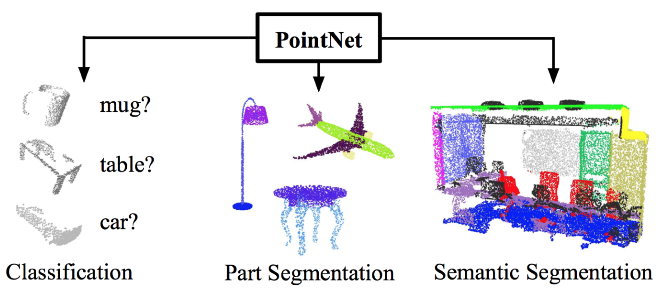
Unified Neural Network Architecture
Citations: 14,430

Slide 5
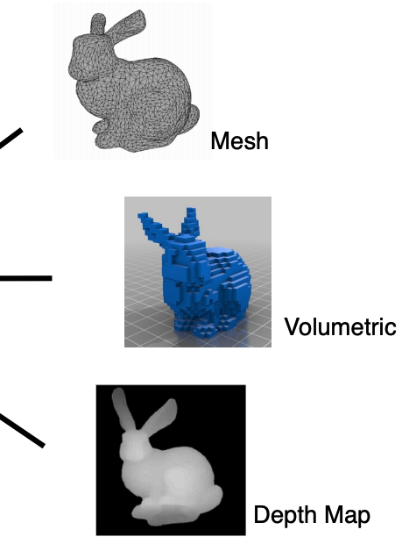
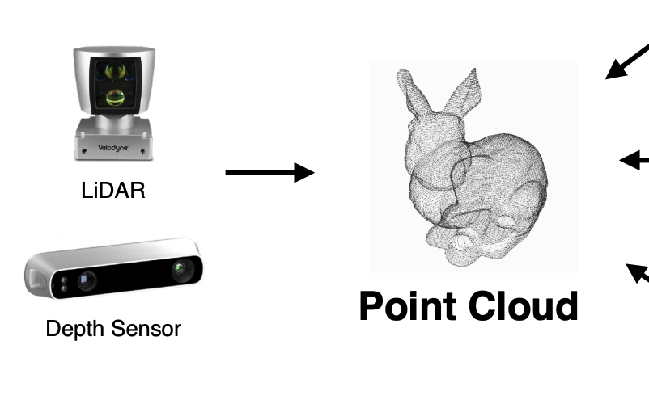
Point Cloud
Point cloud is close to raw sensor data
Point cloud is canonical
Simple and unified structures
Avoid the combinatorial irregularities and complexities of meshes
Easier to learn from

Slide 6
Point cloud Properties
Unordered – Invariant to n! permutations

Slide 7
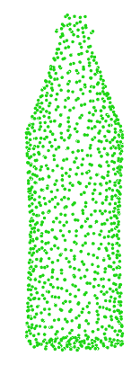
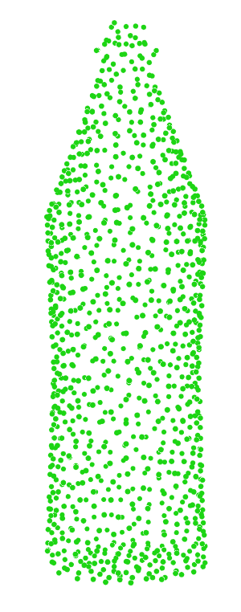
Point cloud Properties
Translation
Rotation
Scale
Y
Y
Z
Z
X
0,0,0
X
0,0,0
Robustness to rigid transformations

Slide 8
Related Works

Slide 9
1. Point Cloud Features
Feature Name | Supports Texture/Color | Local/Global/Regional | Best Use Case
Point Feature Histograms-PFH | No | L
Fast Point Feature Histograms-FPFH | No | L | 2.5D Scans
Clustered Viewpoint Feature Histogram-CVFH | No | G | Object detection + pose estimation
Viewpoint Feature Histogram-VFH | No | R | (as above) + partial object detection
Rotation Invariant Feature Transform-RIFT | Yes | L | 3D scans (no mirror effects)
Reference: https://github.com/PointCloudLibrary/pcl/wiki/Overview-and-Comparison-of-Features
Notes:
https://github.com/PointCloudLibrary/pcl/wiki/Overview-and-Comparison-of-Features

Slide 10
2. Deep Learning on 3D Data
Conversion | Deep Net | Issue
Voxelization | 3D CNNs | Data sparsity + computation cost
Projection/Rendering | 2D CNN | Couldn’t extend to 3D tasks
Feature Extraction | Fully Connected | Representation power of Features Extracted
3. Deep Learning on Unordered Sets
Generic Sets and NLP Applications | lacks the role of geometry in the sets
Ref: Order matters-Sequence to sequence for sets
Notes:
O. Vinyals, S. Bengio, and M. Kudlur. Order matters: Sequence to sequence for sets. arXiv preprint arXiv:1511.06391, 2015. 2, 4, 7

Slide 11
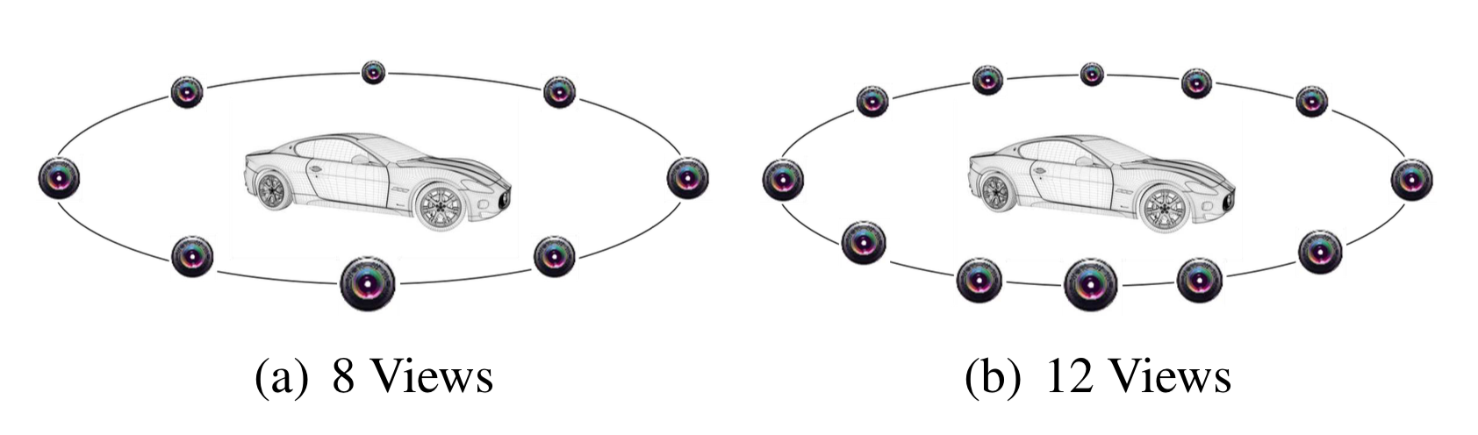
Background (View-based methods)
Represent a 3D shape as a group of 2D views from different angles.
2D projections could cause loss of shape information due to self-occlusions
often demands a huge number of views for decent performance
[4] Feng, Yifan, et al. "GVCNN: Group-view convolutional neural networks for 3D shape recognition.”, CVPR 2018

Slide 12
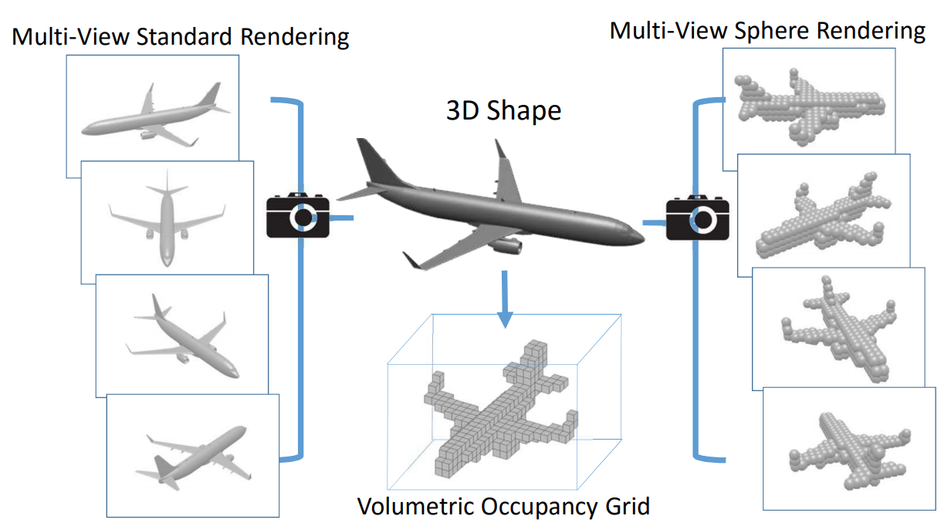
Background (Volumetric methods).
Convert the input 3D shape into a regular 3D grid
3D grid Enforces low resolution - quantization loss of the shape
Subdivision of a bounding volume (not local geometric shape)
higher computational costs
[5] Qi, Charles R., et al. "Volumetric and multi-view cnns for object classification on 3d data.”, CVPR 2016

Slide 13
Problem Statement

Slide 14
Task: Effective Feature Learning directly from Point Cloud
Input
3D points
{P_{i} | i = 1, ..., n}
P_{i} = (x_{i}, y_{i}, z_{i})
Classification
PointNet
Segmentation
(Part or semantic)
Task | Input | Output
Object Classification | directly sampled from a shape or pre-segmented (scene point cloud) | Class labels (k scores)
Part Segmentation | single object | n × m scores
Semantic Segmentation | sub-volume from a 3D scene | n × m scores
k – candidate classes
n – points
m – semantic sub-categories

Slide 15
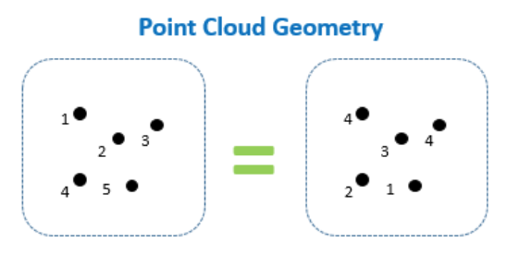
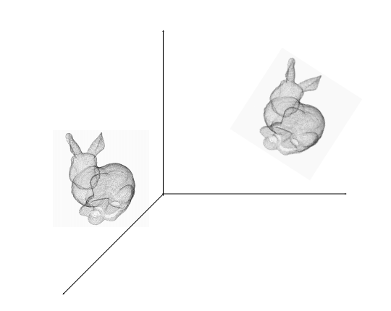
PointSets Properties
Unordered
Invariant to n! permutations
Interaction among points
Not isolated and form meaningful group
Source: http://www.itzikbs.com/3d-point-cloud-classification-using-deep-learning
Invariance under transformation
should not modify the category
Source: https://cse291-i.github.io/LectureSlides/L9_Learning_for_PointCloud_III.pdf

Slide 16
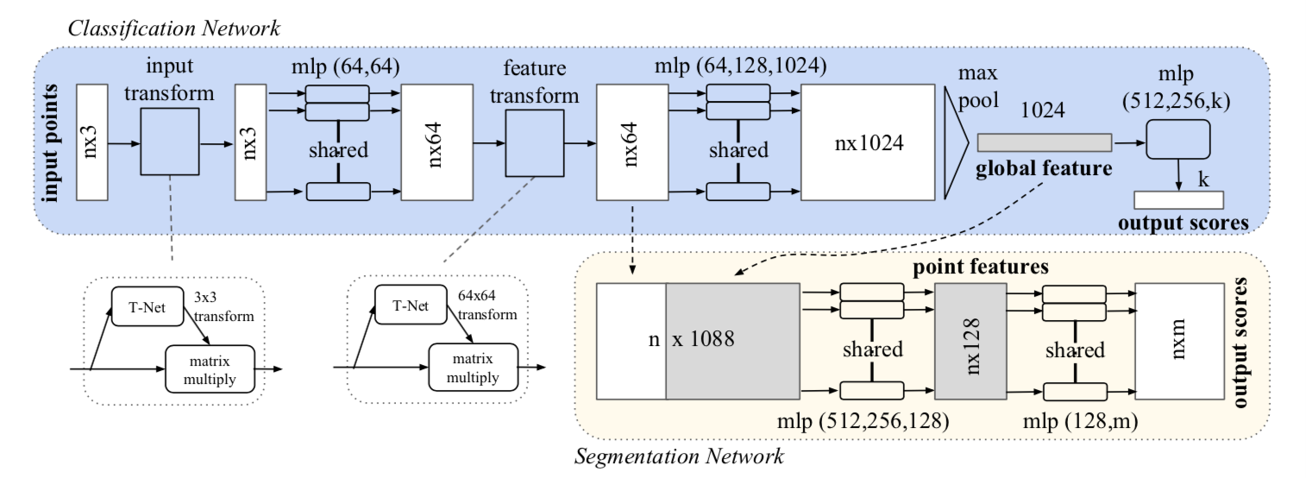
PointNet Architecture
Gives higher dimensional representation of point clouds
Notes:
Each point was ‘projected’ to a 1024 dimension space.
Order problem - symmetric function (max-pool) over the points.(1 x 1024 global feature for every point cloud)
Transformation problem - ‘mini-network’ or T-net.
Transformation matrix over the points (3 x 3) and over mid-level features (64 x 64).
Large increase in the number of parameters - loss term
to constraint the 64 x 64 matrix to be close to orthogonal.

Slide 17
3 key modules
Max pooling layer → symmetric function to aggregate information from all the points
A local and global information combination structure and
Two joint alignment networks → align both input points and point features.

Slide 18
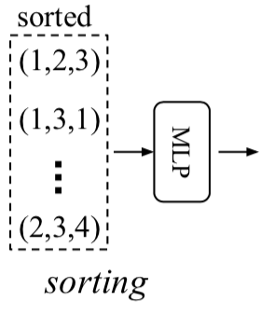
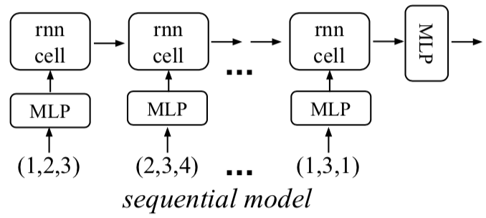
Max pool layer → Symmetry Function for Unordered Input
Challenge: model needs to be invariant to input permutation
Sol 1: Sort input into a canonical order 45% accuracy
→ No canonical ordering in high dimensional space
→ hard for a network to learn a consistent mapping from input to output
Sol 2: Treat input as a sequence - train an RNN(augment training data)78.5% accuracy → “Order Matters” + “RNN forgets”

Slide 19
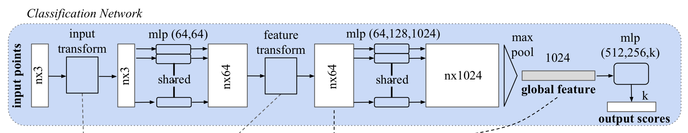
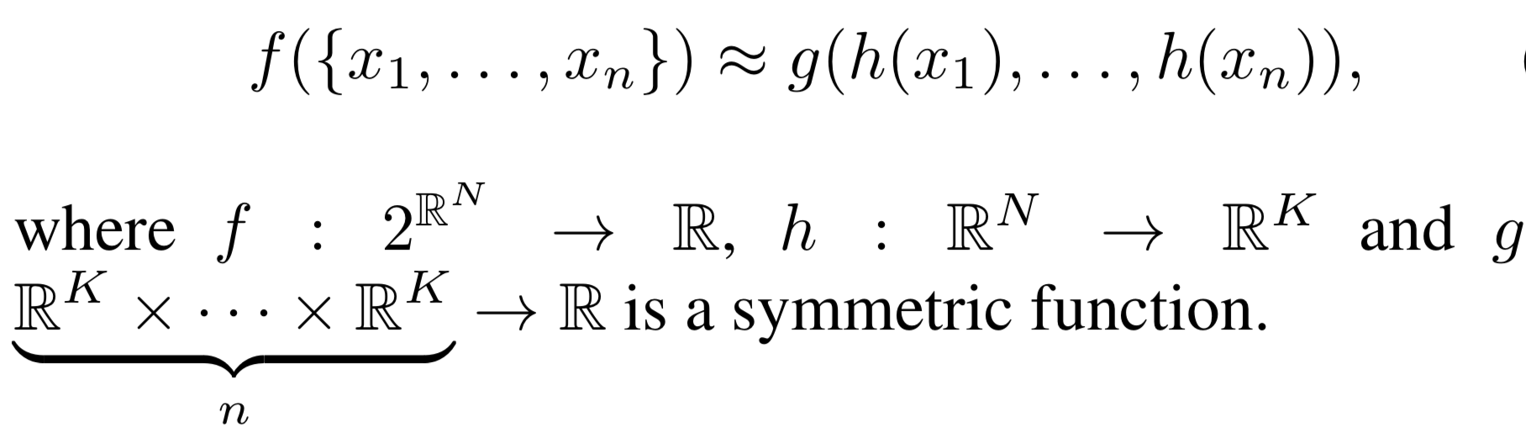
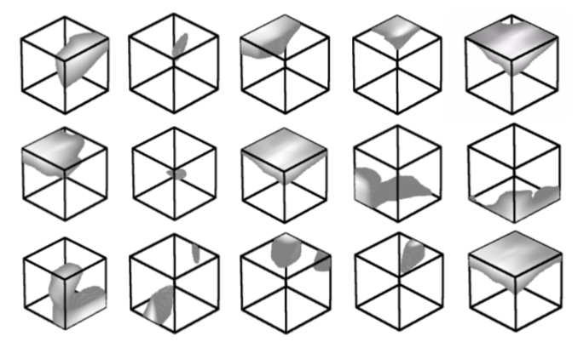
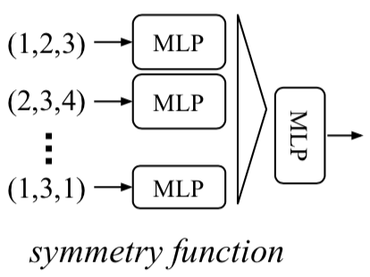
Sample h values
Sol 3: Use a simple symmetric function to aggregate the information from each point.
Notes:
we approximate h by a multi-layer perceptron network and g by a composition of a single variable function and a max pooling function. This is found to work well by experiments. Through a collection of h, we can learn a number of f ’s to capture different properties of the set.

Slide 20
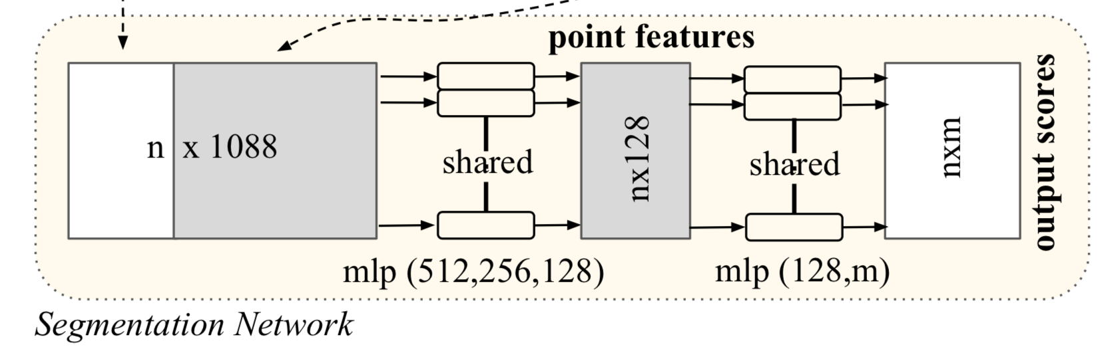
A local and global information combination structure
Local features
nx64
Global features
1x1024
Feed “global point cloud feature vector” back to per point features
Extract new per point features based on the combined point features
New point features → aware of both the local and global information

Slide 21
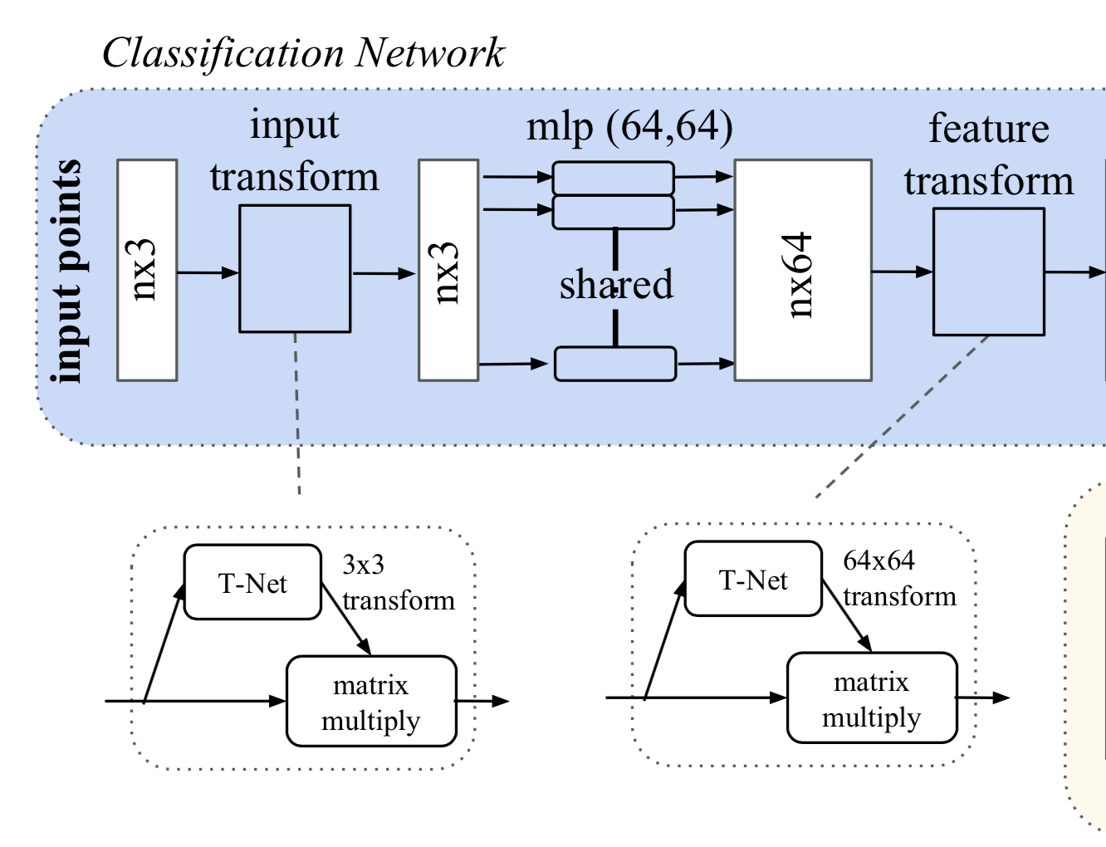
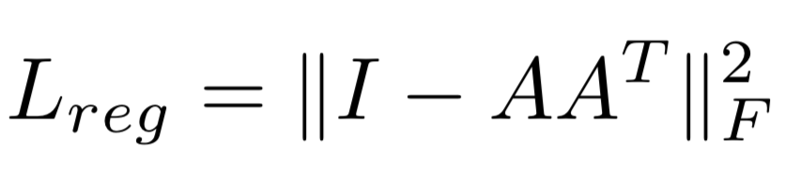
Joint Alignment Network
Source: https://cse291-i.github.io/LectureSlides/L9_Learning_for_PointCloud_III.pdf
Align all input set to a canonical space before feature extraction.
Constrain feature T matrix close to orthogonal matrix (no loss of information)
Regularization - stable optimization & better performance.
Predict an affine transformation matrix
Apply it to the coordinates of input points.
Predict and apply a feature transformation matrix to align features from different input point clouds.
Notes:
feature extraction, max pooling and fully connected layers

Slide 22
Experiment and Results

Slide 23
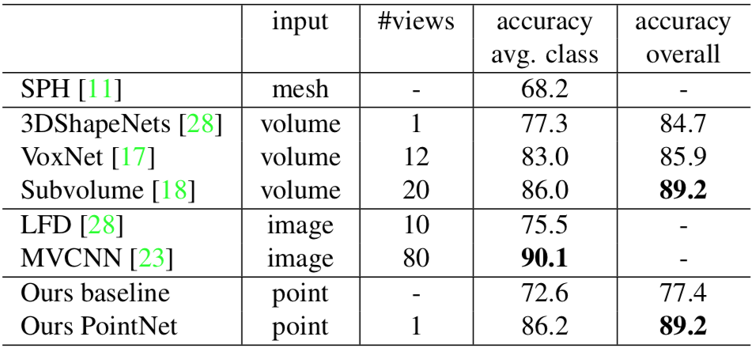
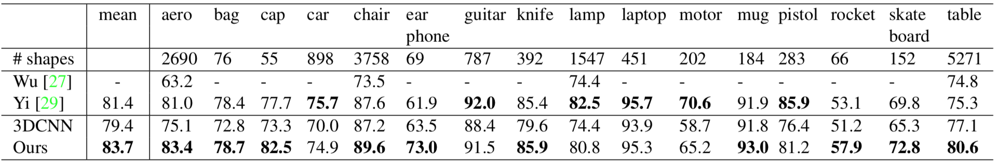
ModelNet40
Classification results
Training | 9843
Testing | 2468
Total CAD models | 12311
Classes | 40
ShapeNet
Total | 16881
Classes | 16
Segmentation results
Notes:
due to the loss of fine geometry details that can be captured by rendered images

Slide 24
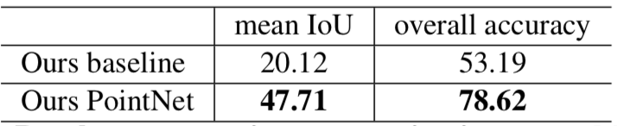
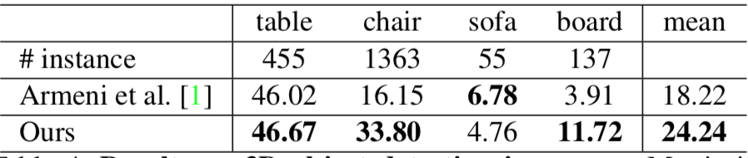
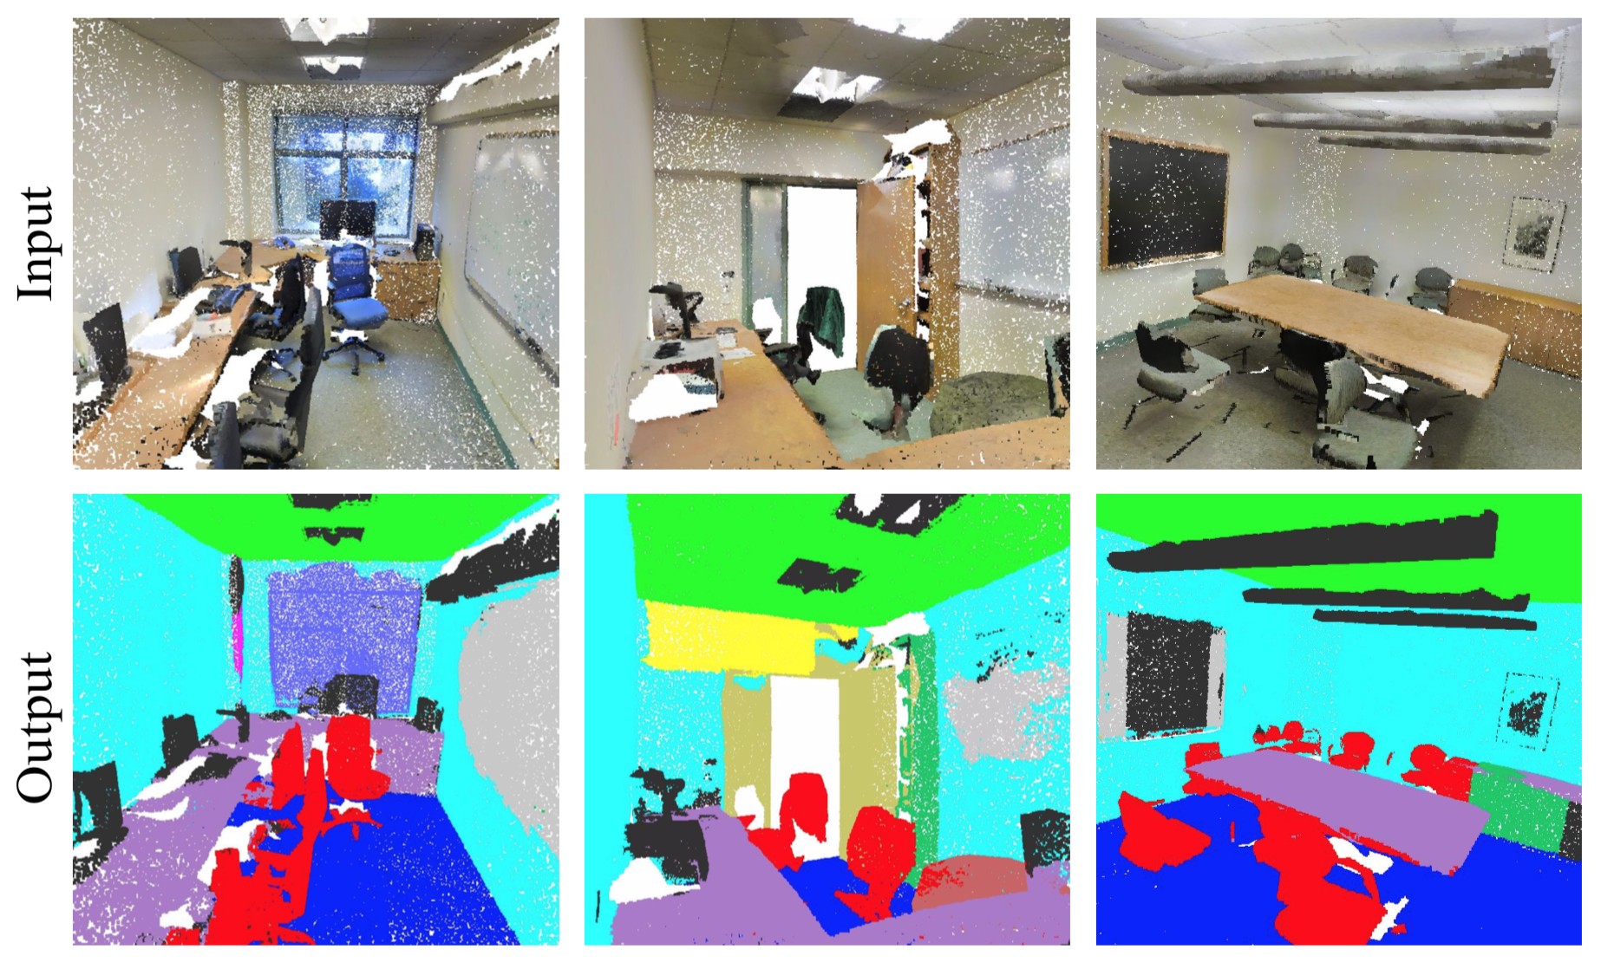
Results on semantic segmentation in scenes.
Results on 3D object detection in scenes.
Qualitative results for semantic segmentation

Slide 25
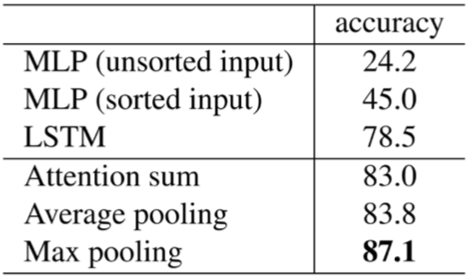
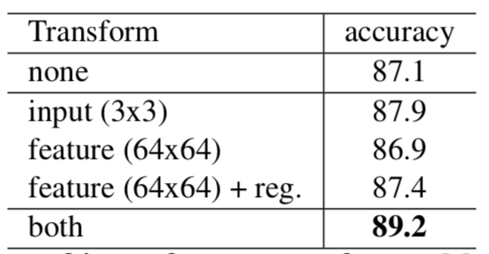
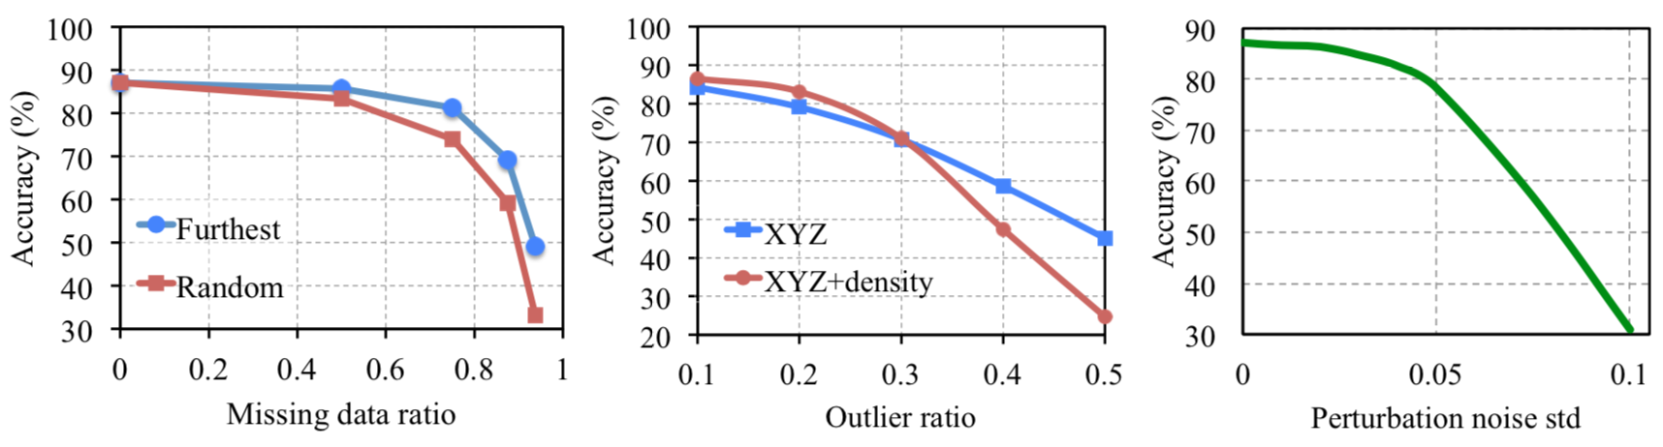
Architecture Design Analysis
Three approaches to achieve order invariance
Effects of input feature transforms.
PointNet robustness test

Slide 26
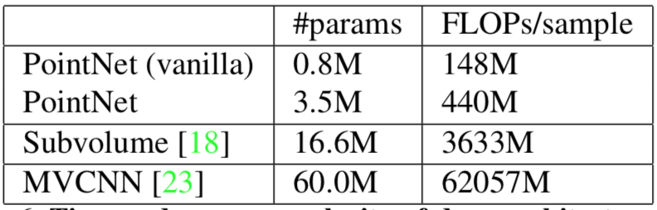
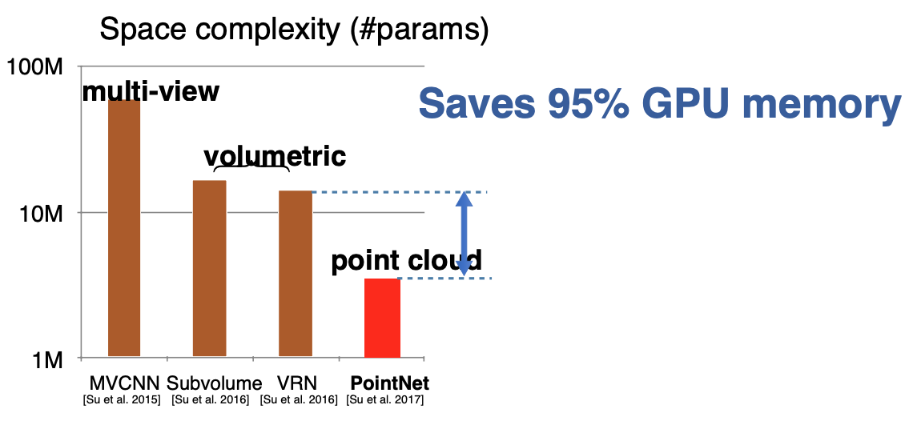
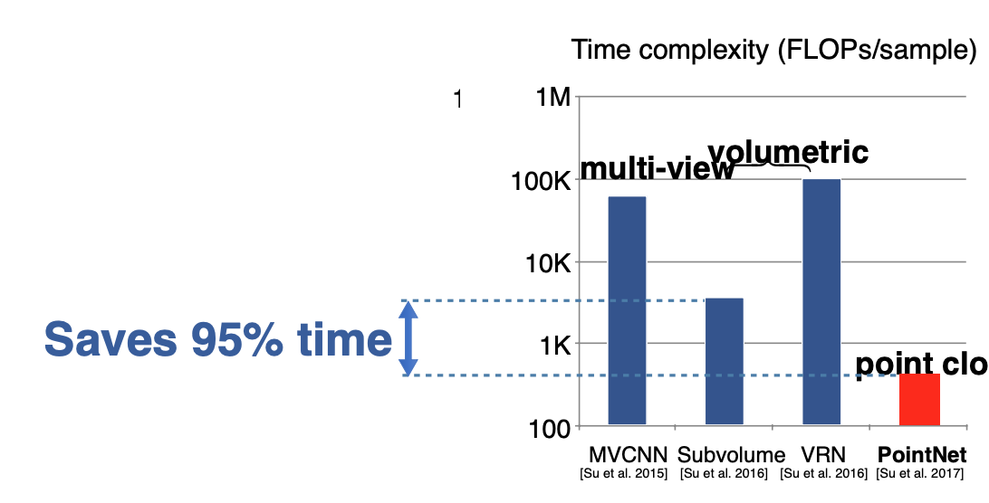
Time and Space Complexity Analysis
Source: https://cse291-i.github.io/LectureSlides/L9_Learning_for_PointCloud_III.pdf
Source: https://cse291-i.github.io/LectureSlides/L9_Learning_for_PointCloud_III.pdf
Notes:
A promising architecture for portable devices

Slide 27
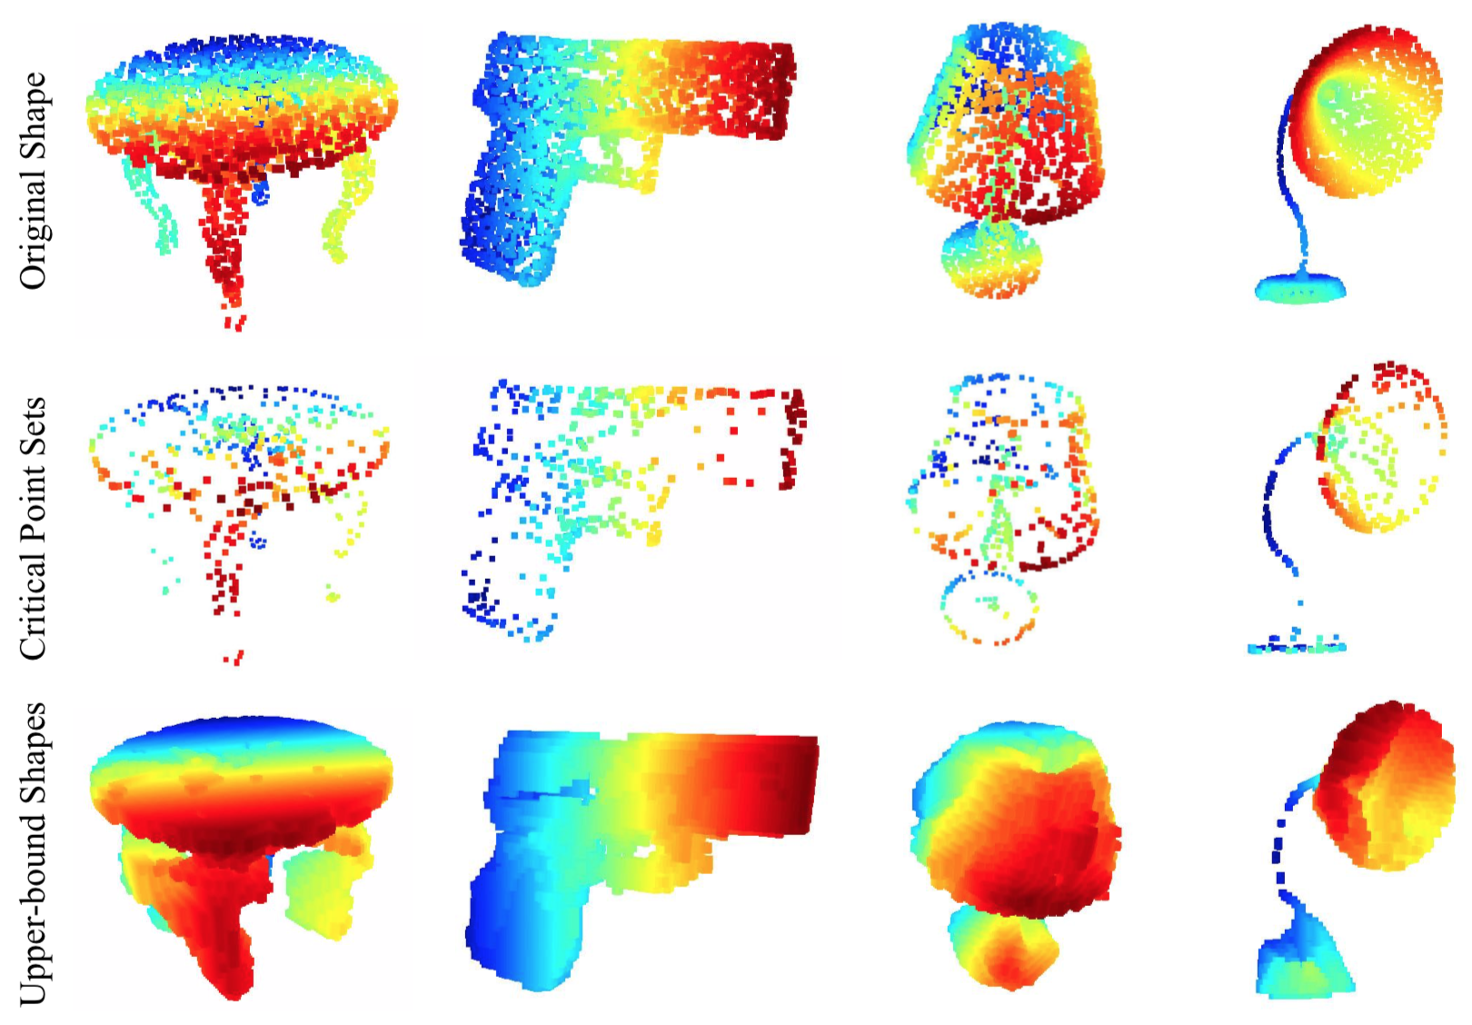
Visualizing PointNet
input point cloud S
contribute to the max pooled feature,
summarize the skeleton of the shape
illustrate the largest possible point cloud
that give the same global shape feature f(S)
as the input point cloud S
Notes:
C_{S} and N_{S} reflect the robustness of PointNet, meaning that losing some non-critical points does not change the global shape signature f(S) at all.

Slide 28
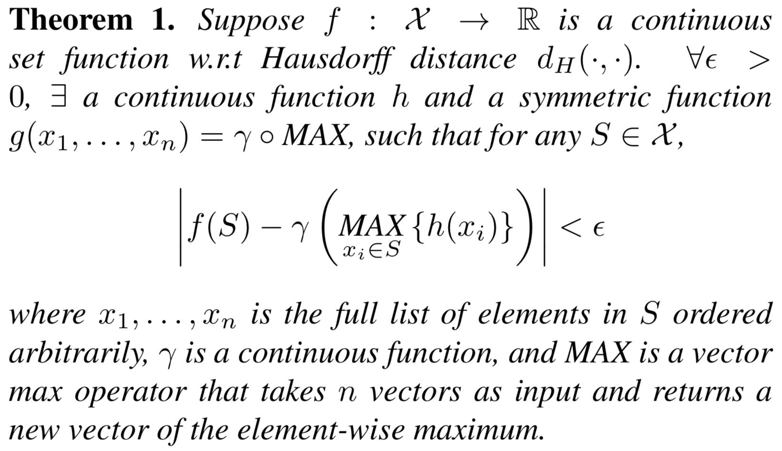
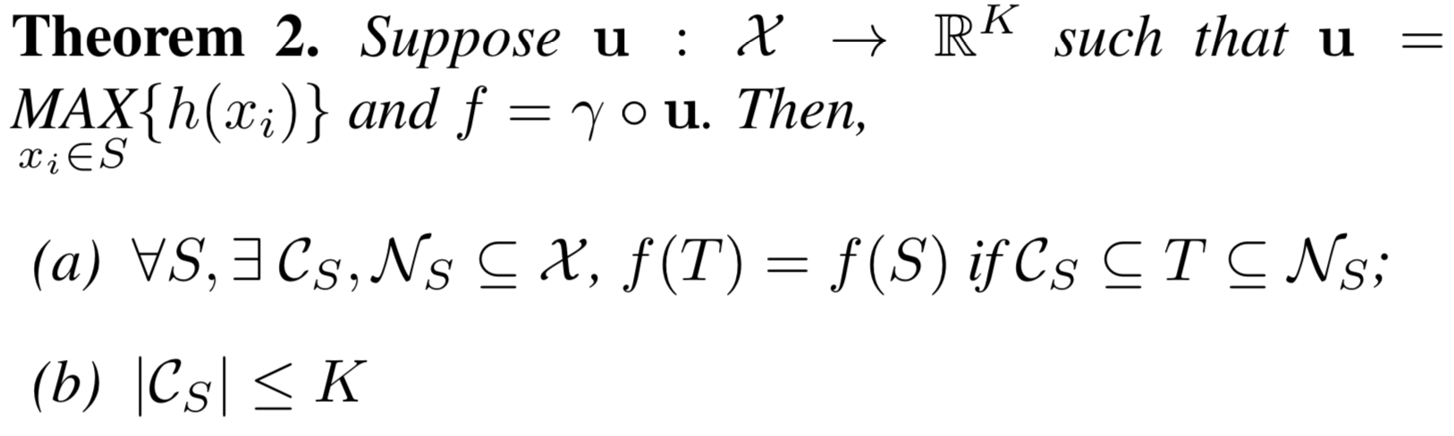
Math
different point functions learn to detect for points in
different regions with various shapes scattered in the
whole space.
small corruptions or extra noise points in the input set
are not likely to change the output of the network
Notes:
The key idea is that in the worst case the network can learn to convert a point cloud into a volumetric representation, by partitioning the space into equal-sized voxels. In practice, however, the network learns a much smarter strategy to probe the space, as we shall see in point function visualizations.

Slide 29
PointNet segmentation failure cases

Slide 30
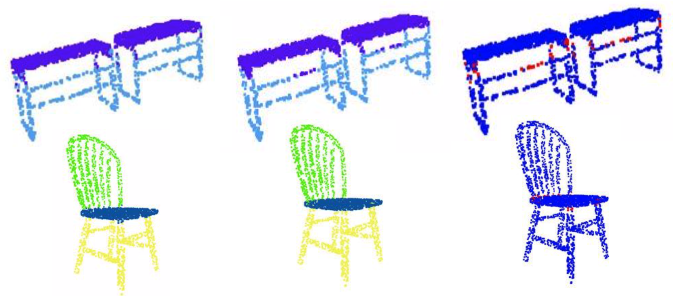
1. The points on the boundary are wrongly labeled
Prediction Ground Truth Difference Maps

Slide 31
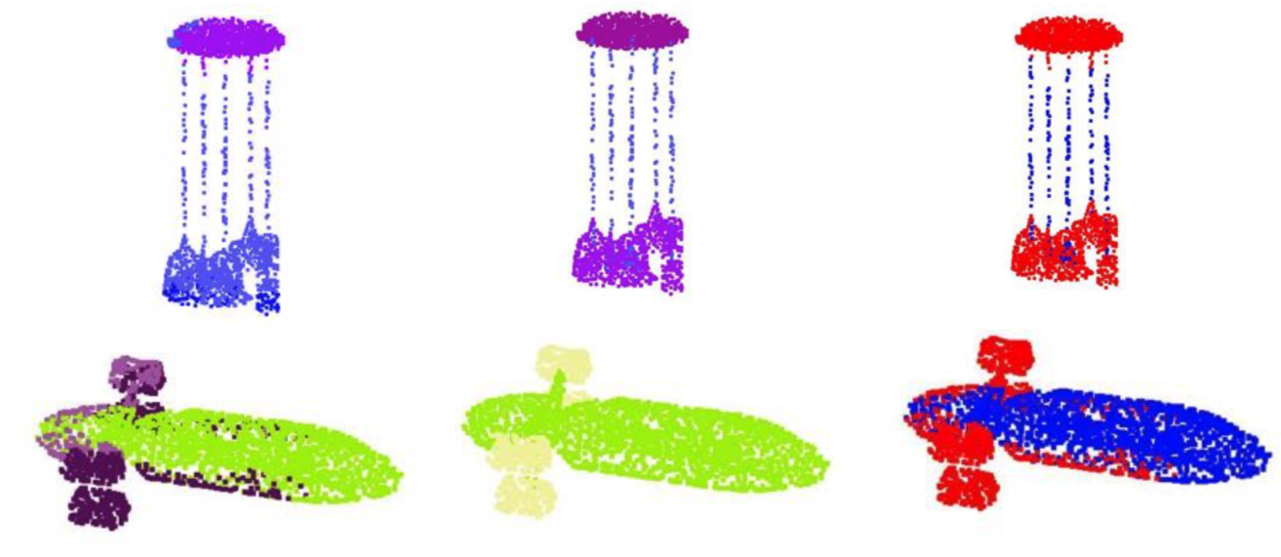
2. shows the errors on exotic shapes
Prediction Ground Truth Difference Maps

Slide 32
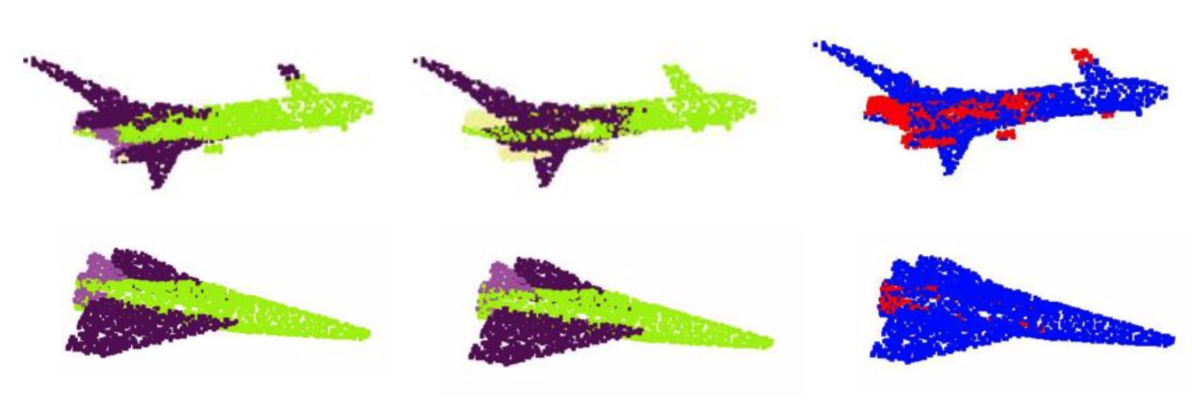
3. small parts can be overwritten by nearby large parts
Prediction Ground Truth Difference Maps

Slide 33
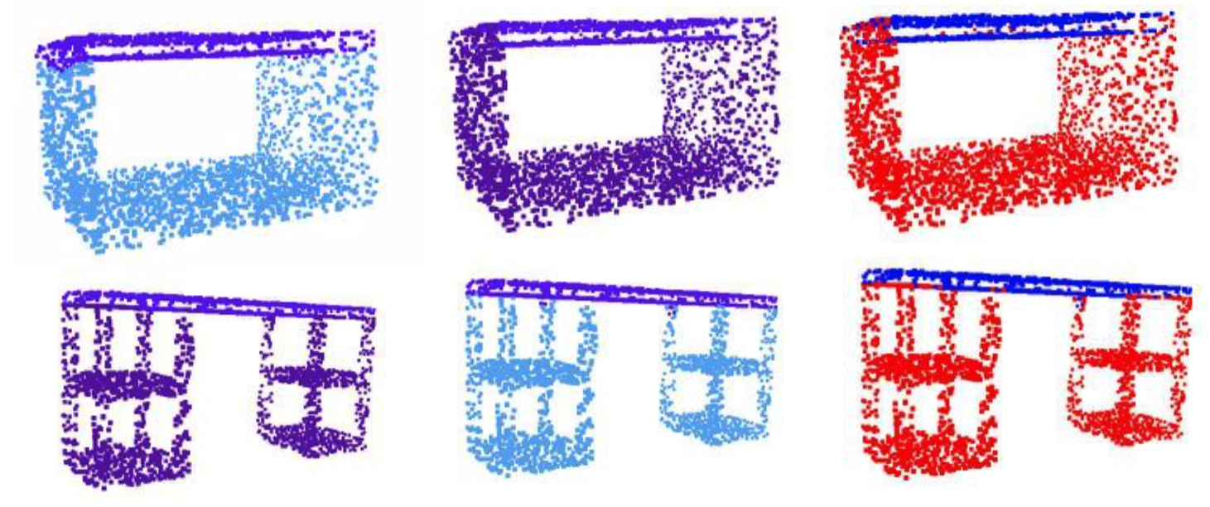
4. shows the error caused by the inherent ambiguity of shape parts
Prediction Ground Truth Difference Maps

Slide 34
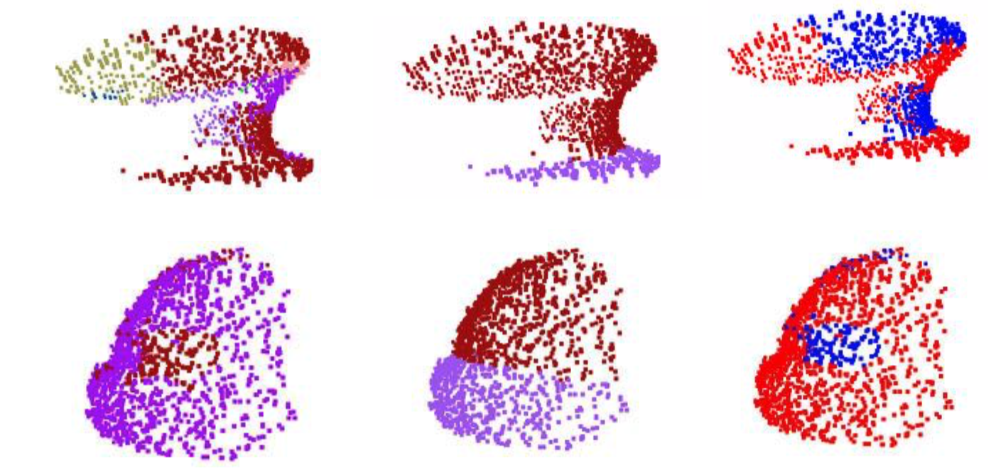
5. error introduced by the incompleteness of the partial scans
Prediction Ground Truth Difference Maps

Slide 35
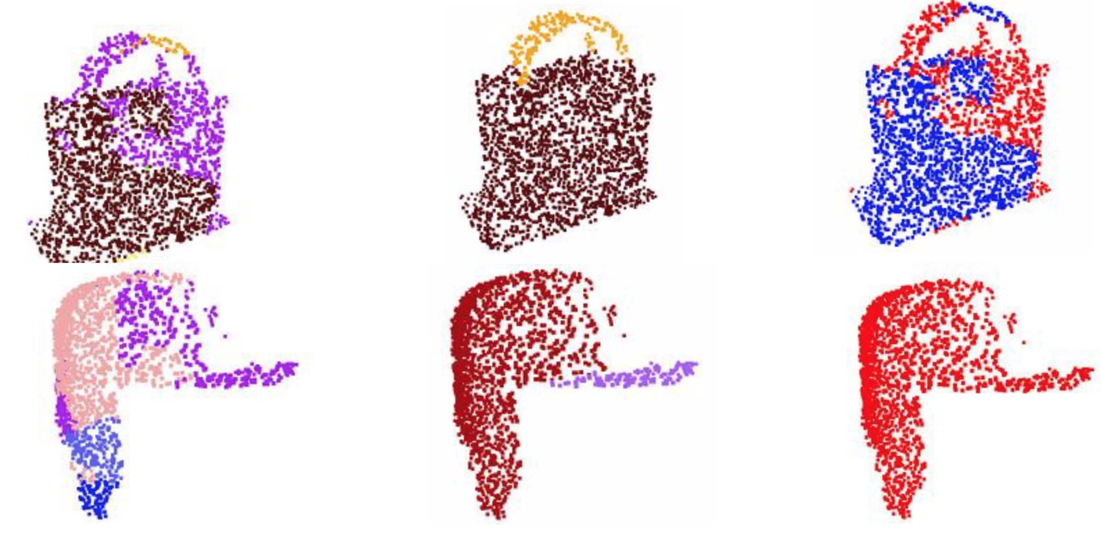
6. object categories have too less training data to cover enough variety
Prediction Ground Truth Difference Maps

Slide 36
Questions ?

Slide 37
why pointnet not using
local neighborhoods of points?

